Slide 1
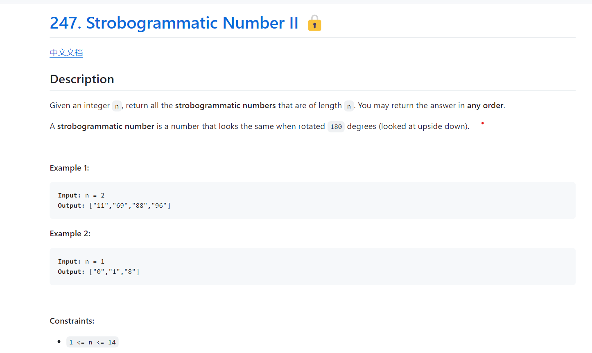
difficulty: Medium
Company Tag – Facebook 4 , Google 2, Uber 3
tags: - Recursion - Array - String

Slide 2
Python
class Solution:
def findStrobogrammatic(self, n: int) -> List[str]:
def dfs(u):
if u == 0:
return ['']
if u == 1:
return ['0', '1', '8']
ans = []
for v in dfs(u - 2):
for l, r in ('11', '88', '69', '96'):
ans.append(l + v + r)
if u != n:
ans.append('0' + v + '0')
return ans
return dfs(n)

Slide 3
class Solution {
private static final int[][] PAIRS = {{1, 1}, {8, 8}, {6, 9}, {9, 6}};
private int n;
public List<String> findStrobogrammatic(int n) {
this.n = n;
return dfs(n);
}
private List<String> dfs(int u) {
if (u == 0) {
return Collections.singletonList("");
}
if (u == 1) {
return Arrays.asList("0", "1", "8");
}
List<String> ans = new ArrayList<>();
for (String v : dfs(u - 2)) {
for (var p : PAIRS) {
ans.add(p[0] + v + p[1]);
}
if (u != n) {
ans.add(0 + v + 0);
}
}
Java

Slide 4
return ans;
}
}
C++
class Solution {
public:
const vector<pair<char, char>> pairs = {{'1', '1'}, {'8', '8'}, {'6', '9'}, {'9', '6'}};
vector<string> findStrobogrammatic(int n) {
function<vector<string>(int)> dfs = [&](int u) {
if (u == 0) return vector<string>{""};
if (u == 1) return vector<string>{"0", "1", "8"};
vector<string> ans;
for (auto& v : dfs(u - 2)) {
for (auto& [l, r] : pairs) ans.push_back(l + v + r);
if (u != n) ans.push_back('0' + v + '0');
}
return ans;
};
return dfs(n);
}
};

